Slide 1

20104079 Kalpesh Chavan
20104111 Siddhant Darekar
20104082 Ankit Awade
Project Guide
Prof. Roshna Sangle

Slide 2

Topic : URCorporator
- Mini Project (2A)

Slide 3

Contents
◆ Introduction
◆ Objectives
◆ Scope
◆ Literature Survey
◆ Proposed System
◆ Project Outcomes
◆ Data Flow Diagram
◆ Use Case Diagram
◆ Technology Stack
◆ Suggestions in Review-1
◆ Result and Discussion
◆ Conclusion and Future Scope
◆ References

Slide 4

1. Introduction
• Problem Identified:
- Fake News Scams
- Poor Policing
- Lack of freedom to speak
- Political Arrogance
• Solution Proposed:
- The convenience
- Access anytime (24/7)
- Genuine News Source
- Save your efforts
- Political Information

Slide 5

2. Objectives
• To build a bridge between citizens and
government
• To empower people to connect with the
government and contribute towards good
governance
• To drive behavioral change, fighting
fake news and busting myths
• To introduce various government
schemes and programs for the people

Slide 6

3. Scope
• To provide users, facility to make complaint
with any device
• To provide users to check status of their
grievances
• To reduce user's time by just uploading photo
• To provide user the SMS facility to
acknowledge user's
• To provide user a user friendly environment
• To provide a delete complaint facility for
corporator (for fake news)

Slide 7

4. Literature Survey
Existing System
Proposed System
In the existing system the user can In this system the user can not only
just read the content and can
explore the various tabs .
just explore the website but can also
upload the images and can register
the complaint.
This System has user friendly
interface and Beautiful GUI
This Proposed System too has good
user friendly Interface
This Website is developed by html, This System is developed by html,
CSS, JavaScript CSS, JavaScript, bootstrap.

Slide 8

5. Proposed System
• Help or Feedback Column
-If any customer has issue regarding
quality of service etc. can contact us on
help or feedback Column
• Latest News
-We provide our user with latest news
regarding any government policies,
schemes etc.

Slide 9

6. Outcome of Project
◆ Users can login/register
◆ User will be able to file a Complaint by posting a
picture
◆ After attending the request/complaint
of users they will receive a notification on
task completion
◆ Users will be aware of overall development of their
respective constituency/ward

Slide 10
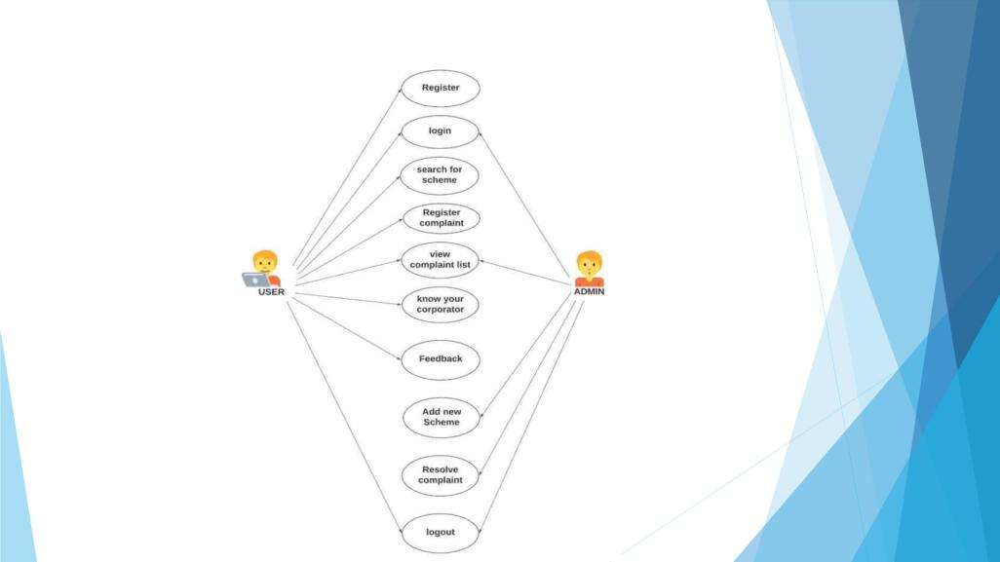
7. Use Case Diagram

Slide 11
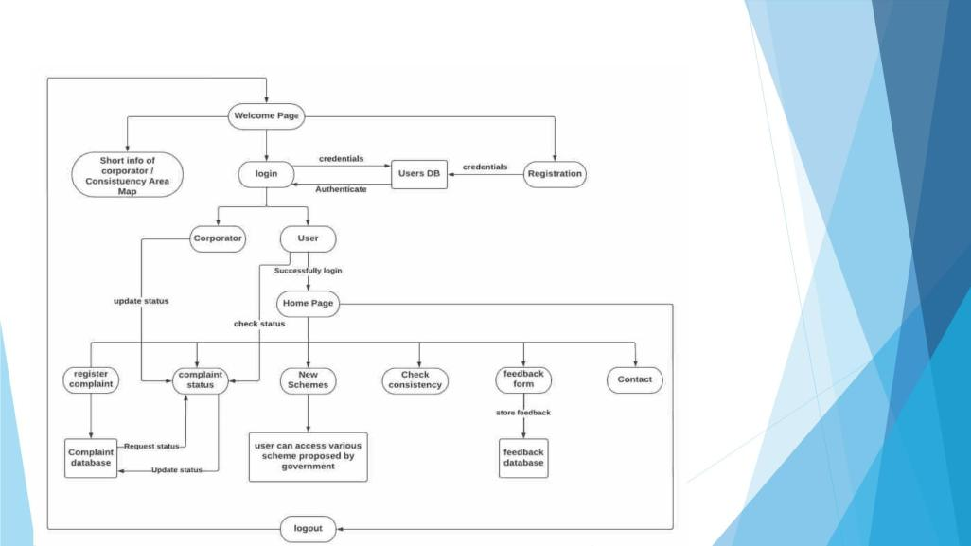
8. Dataflow Diagram

Slide 12

9. Technology Stack
◆ Web application built on
VisualStudio
HTML
CSS
JavaScript
XAMPP

Slide 13

10. Suggestions in Review-1
◆ Improvement in GUI
◆ Correction in DFD/Block Diagram
◆ Content rich website
◆ Improvisation in Report and Diagrams
◆ Upgrading website features
◆ Make use of Data-base

Slide 14
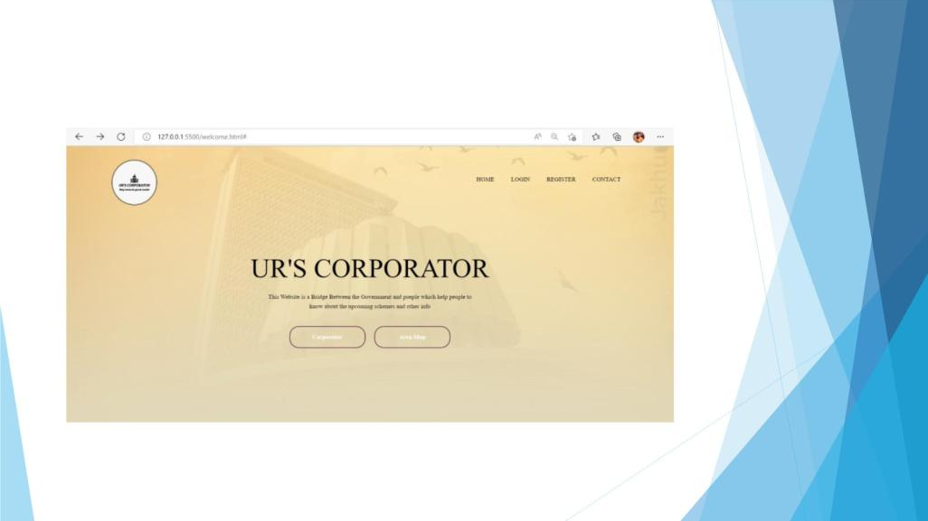
11. Result and Discussion

Slide 15
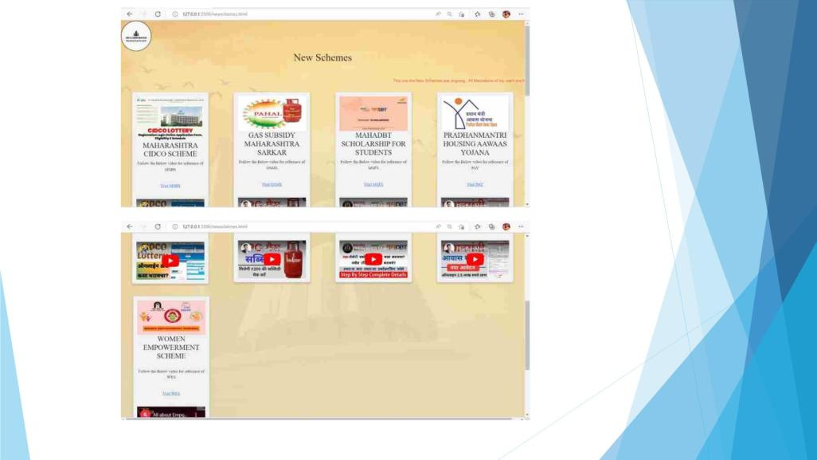

Slide 16
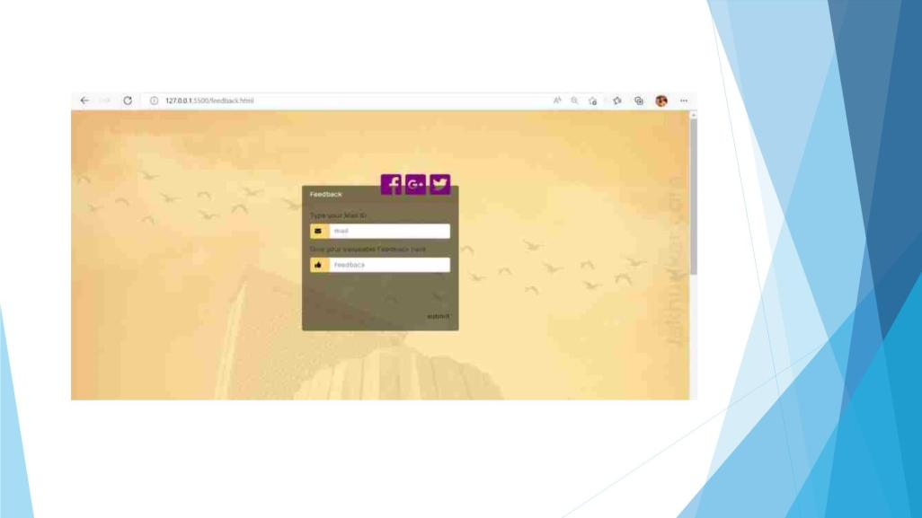

Slide 17

12. Conclusion and Future Scope
◆ To add a chat box on website
◆ To add a news segment in website
◆ To add a virtual assistant in website
◆ To make website more creative by
adding more images and videos
◆ To add language changing mode
◆ To insert various mode of alert and
notifications

Slide 18

10. References
◆ 1. https://www.researchgate.net/publication/357717809
Accessibility analysis using WCAG 21 evidence from Indian e-
government websites
◆ 2. https://www.researchgate.net/publication/320068457
Accessibility and Usability of Government Websites in Tanzania
◆ 3. https://www.researchgate.net/publication/224303952 Building
Citizen Trust towards E-Government Services Do High Quality
Websites Matter

Slide 19


